Slide 1
Nigerian Healthcare Analysis
Presented by
Confidence Ihediohamma

Slide 2
Table of Contents
01
02
03
Introduction
Problem
Statement
KPI and
Objectives
04
05
Analysis and Findings
Recommendation and
Conclusion

Slide 3
Introduction
This project explores disease incidence and mortality trends across the Nigerian states, within the year 2009 till 2018, covering all age groups, and settlement populations. The analysis identifies high-risk states, most affected age groups, and year-over-year disease patterns to support data-driven public health decisions.

Slide 4
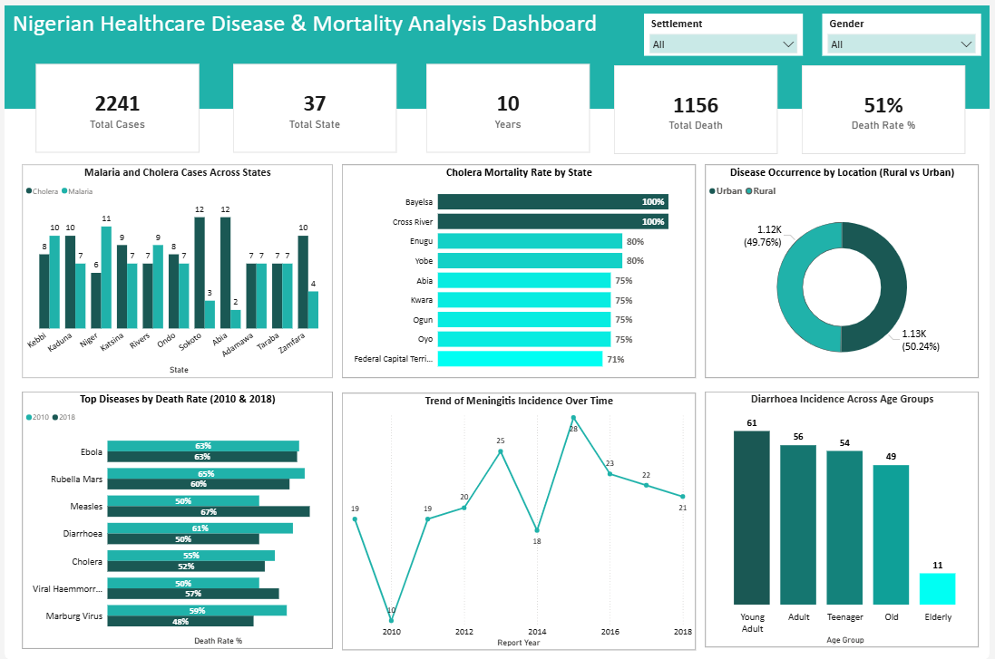

Slide 5
Problem Statement
Infectious diseases vary across different Nigeria regions, populations, and time, impacting public health planning. This analysis addresses key questions on incidence, mortality, and vulnerable groups.
Which states has the highest incidence of Malaria and Cholera?
Which State has the highest death rate due to Cholera?
Which group do we have the highest disease occurrence, rural or urban?
Which diseases has the highest death rate in 2010 and 2018?
Which year do we have highest incidence of Meningitis?
Which Age group are more susceptible to Diarrhea?

Slide 6

Key Performing indicators
Total Cases: 2241
Total numbers of casses within the country
Total State: 37
Total numbers of states recorded.
Years: 10
Total numbers of years.
Total Death: 1156
Total number od recorded death incidence across the states
Total Death Rate: 51%
Percentage of death rate within the country

Slide 7
Objectives
To analyze disease incidence, mortality trends, and demographic vulnerability across states and years, enabling data-driven public health decisions and targeted interventions.

Slide 8
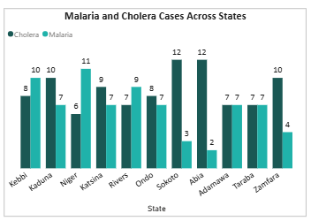
Key Findings
Sokoto and Abia show the highest combined incidence of Cholera, indicating higher cholera disease burden in these states.
Abia has the lowest reported case for malaria, suggesting either better disease control or lower incidence.
In most states, Cholera cases appear slightly higher than Malaria, indicating cholera may require more targeted interventions in these areas.

Slide 9
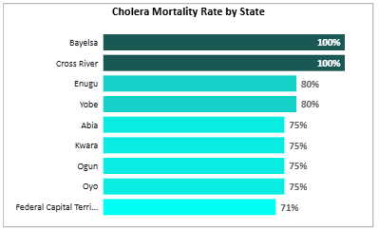
Key Findings
Bayelsa and Cross River recorded the highest cholera mortality rate at 100%, indicating extremely severe outcomes for reported cases.
Enugu and Yobe follow with 80% mortality, which is also significantly high.
The high mortality rates across several states highlight possible gaps in access to timely treatment and healthcare resources.

Slide 10
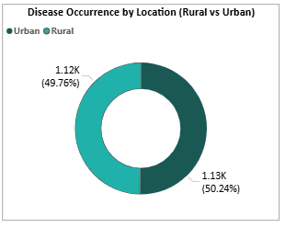
Key Findings
Disease occurrence is almost evenly distributed between rural and urban areas.
Urban areas account for about 50.24% of cases, slightly higher than rural areas.
The small difference suggests that disease spread affects both locations similarly, emphasizing the need for nationwide public health interventions rather than location-specific focus alone.

Slide 11
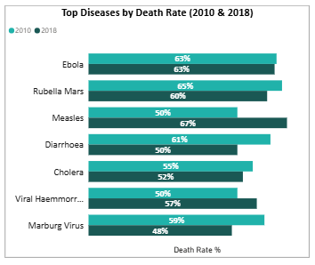
Key Findings
Measles experienced the largest increase in death rate, rising from 50% in 2010 to 67% in 2018.
Viral Hemorrhagic Fever also increased from 50% to 57%, indicating worsening outcomes.
Rubella showed a decline in death rate, suggesting improved treatment or vaccination coverage.
Ebola maintained a consistently high death rate (63%), highlighting its continued severity.

Slide 12
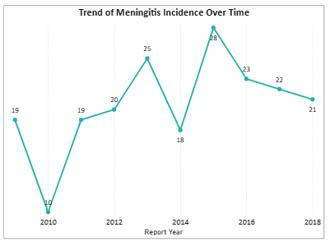
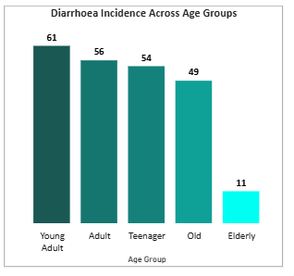
Key Findings
The lowest incidence occurred in 2010, with 10 cases.
The highest meningitis incidence occurred in 2015, with 28 reported cases, indicating a significant increase after 2010 low occurrence.
After the peak in 2015, there was a steady decline in cases, suggesting improved disease control measures and interventions over time.
Young adults recorded the highest diarrhea incidence (61 cases), making them the most affected group.
Adults and teenagers also show relatively high incidence levels.
The elderly group recorded the lowest incidence (11 cases).
This pattern suggests that working-age populations may have higher exposure to risk factors such as contaminated food or water sources.

Slide 13
Recommendation
High-incidence states such as Sokoto, Kebbi, and Niger should receive targeted public health interventions, including mosquito net distribution, sanitation programs, and improved access to clean water.
States with extremely high cholera mortality rates should strengthen emergency healthcare response by improving early diagnosis, treatment availability, and rapid medical intervention.
Healthcare infrastructure should be expanded in both urban and rural areas since disease occurrence is almost evenly distributed across the two settlement types.
Vaccination and disease control programs should be intensified to reduce the rising death rates observed in diseases such as measles and viral hemorrhagic fever.
Public health education campaigns should focus on young adults and adults, as they show the highest incidence of some disease e.g., diarrhea.
Health authorities should implement stronger disease surveillance and early warning systems to detect and respond quickly to outbreaks such as the spike in meningitis cases.

Slide 14
Conclusion
The analysis reveals significant variations in disease incidence and mortality across Nigerian states, years, and population groups. Certain states experience higher cases of malaria and cholera, while some diseases exhibit notably high mortality rates. Disease occurrence is almost evenly distributed between rural and urban areas, and specific age groups are more affected by illnesses such as diarrhea. These findings highlight the need for targeted public health interventions, improved disease monitoring, and strengthened healthcare systems to reduce disease burden and mortality.

Slide 15
Thank you

